Slide 1
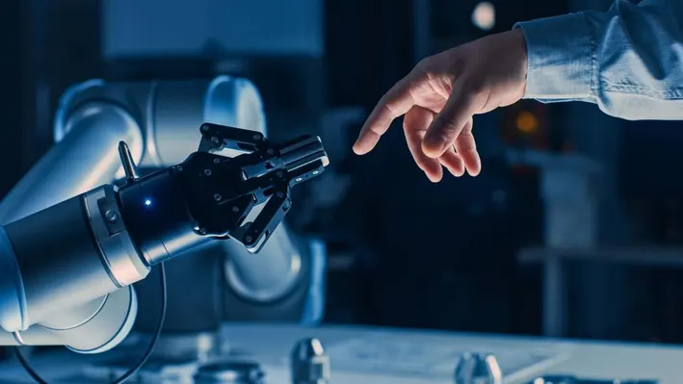
Impact of varying collision avoidance strategies on human stress level in human-robot interaction.
Adobe Stock Image
Fakultät ET/IT Lehrstuhl RST, 09.01.2024
Mohammed Faizan​
Supervisors : M.sc. Heiko Renz , M.sc. Khazar Dargahi Nobari
Univ.-Prof. Dr.-Ing. Prof. h.c. Dr. h.c. Torsten Bertram
Institute of Control Theory and Systems Engineering

Slide 2
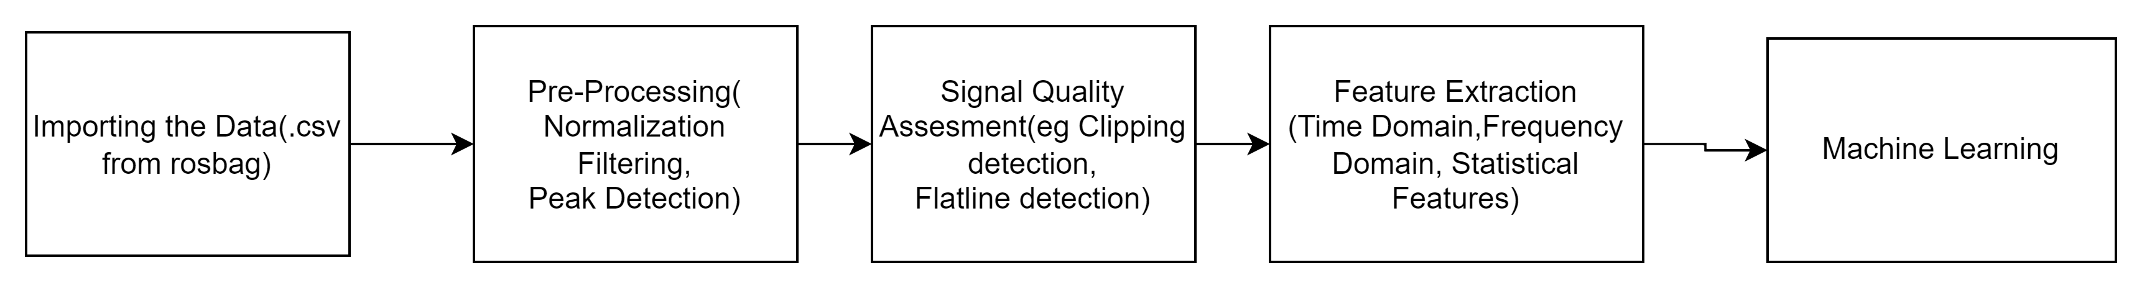
Pipeline for Stress Detection and Classification
Logistic Regression
K-nearest Neighbors
Support Vector Machine
Decision Trees Classifier
Random Forest Classifier
XGBoost Classifier
Using a threshold to define Stress - threshold which is one standard deviation above the mean of particular data.
.

Slide 3
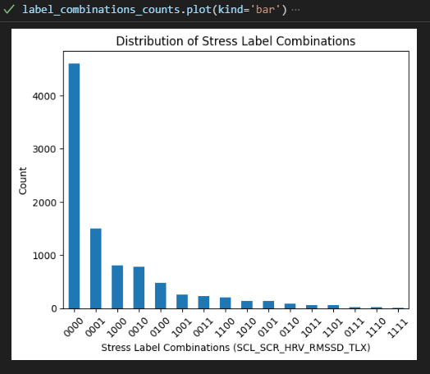
Current Implementation
Current Indicators taken for stress label
SCR_mean
SCL_mean
HRV_RMSSD
TLX
Others Implemented yet to be added
Derivatives of PPG features
Yet to be implementated
Acc/Motion
No of Different label combinations
SCL SCR HRV_RMSSD TLC
Combination No of Labels
0000 4606
0001 1499
1000 811
0010 780
0100 480
1001 253
0011 232
1100 203
1010 144
0101 138
0110 83
1011 61
1101 58
0111 24
1110 23
1111 6

Slide 4
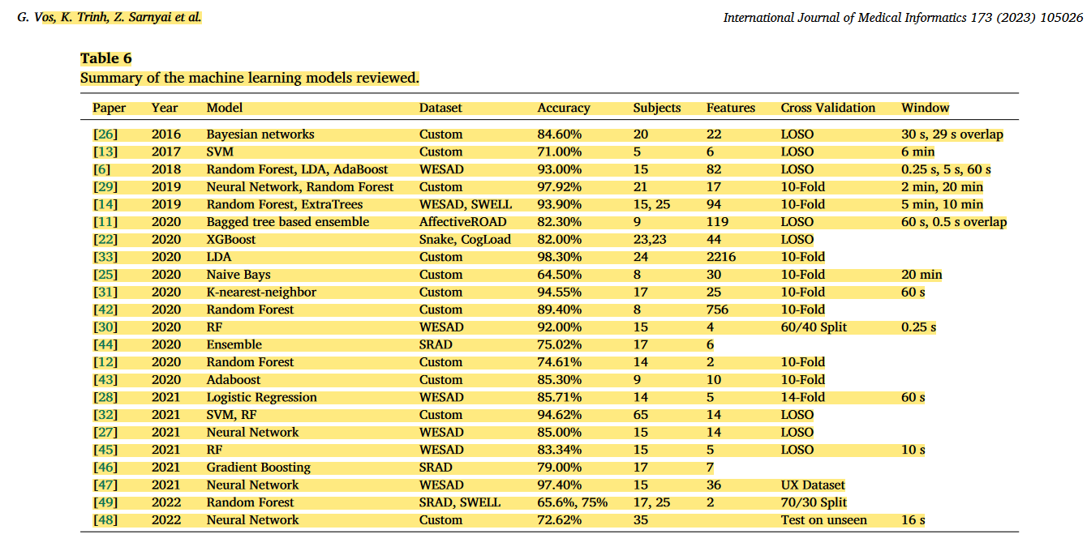
Vos, Gideon, Kelly Trinh, Zoltan Sarnyai, and Mostafa Rahimi Azghadi. ‘Generalizable Machine Learning for Stress Monitoring from Wearable Devices: A Systematic Literature Review’. International Journal of Medical Informatics 173 (May 2023): 105026. https://doi.org/10.1016/j.ijmedinf.2023.105026.

Slide 5
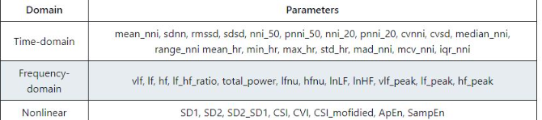
Heart Rate Variablity Features
Calculates time-domain hrv parameters.
mean_nni: mean of peak to peak intervals sdnn: standard deviation of peak to peak intervals. Often calculated over a 24-hour period. rmssd: root mean square of successive differences between peak to peak intervals sdsd: standard deviation of successive differences between peak to peak intervals nni_50: number of pairs of successive intervals that differ by more than 50 ms pnni_50: ratio of nni_50 to total number of intervals nni_20: number of pairs of successive intervals that differ by more than 20 ms pnni_20: ratio of nni_20 to total number of intervals cvnni: ratio of sdnn to mean_nni cvsd: ratio of rmssd to mean_nni median_nni: median of absolute values of successive differences between peak to peak intervals range_nni: range of peak to peak intervals mean_hr: mean heart rate min_hr: minimum heart rate max_hr: maximum heart rate std_hr: standard deviation of heart rate mad_nni: mean absolute deviation of peak to peak intervals mcv_nni: ratio of mead_nni to median_nni iqr_nni: interquartile range of peak to peak intervals
Calculates frequency-domain hrv parameters.
vlf: Spectral power pertaining to very low frequency band (0.0033 to 0.04 Hz by default.) lf: spectral power pertaining to low frequency band (0.04 to 0.15 Hz by default.) hf: spectral power pertaining to high frequency band (0.15 to 0.4 Hz by default.) lf_hf_ratio: ratio of lf to hf total_power: sum of vlf, lf and hf lfnu: normalized spectral power pertaining to low frequency band (ratio of lf to total_power) hfnu: normalized spectral power pertaining to high frequency band (ratio of hf to total_power) lnLF: log transformed low-frequency power lnHF: log transformed high-frequency power vlf_peak: max peak of power spectral density in very low frequency band lf_peak: max peak of power spectral density in low frequency band hf_peak: max peak of power spectral density in high frequency band

Slide 6
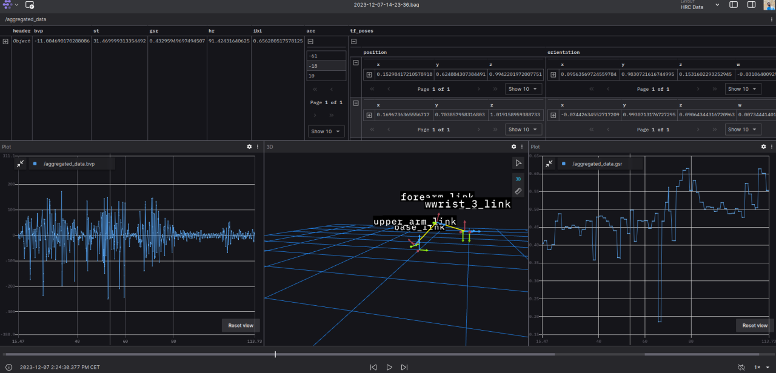

Slide 7

Thank you for your kind attention!
Adobe Stock Image
Univ.-Prof. Dr.-Ing. Prof. h.c. Dr. h.c. Torsten Bertram
Institute of Control Theory and Systems Engineering

Slide 8
Updates since last week
Recap:
Last week 9 participants done- Total of 20 participants done atm.(Should I do more? Don’t have anything scheduled for this week)
Some motion capture data very bad compared to others being perfect- Most likely due to loose fitting size of the suit and also slouching.
Started with processing of data and feature extraction using BIOBSS python library.
Hopefully have something ready over the holidays.
Notes:
Printout of consent form
Any rules to follow when bringing in participants

Slide 9
Updates since last week
Recap:
Last week 9 participants done- Total of 20 participants done atm.
Some motion capture data very bad compared to others being perfect- Most likely due to fitting size of the suit and also
Next steps : Processing the data harder than expected( Available libraries for Python :
HeartPy, FLIRT, BioSPPY or for Matlab:Ledalab)
Notes:
Printout of consent form
Any rules to follow when bringing in participants

Slide 10
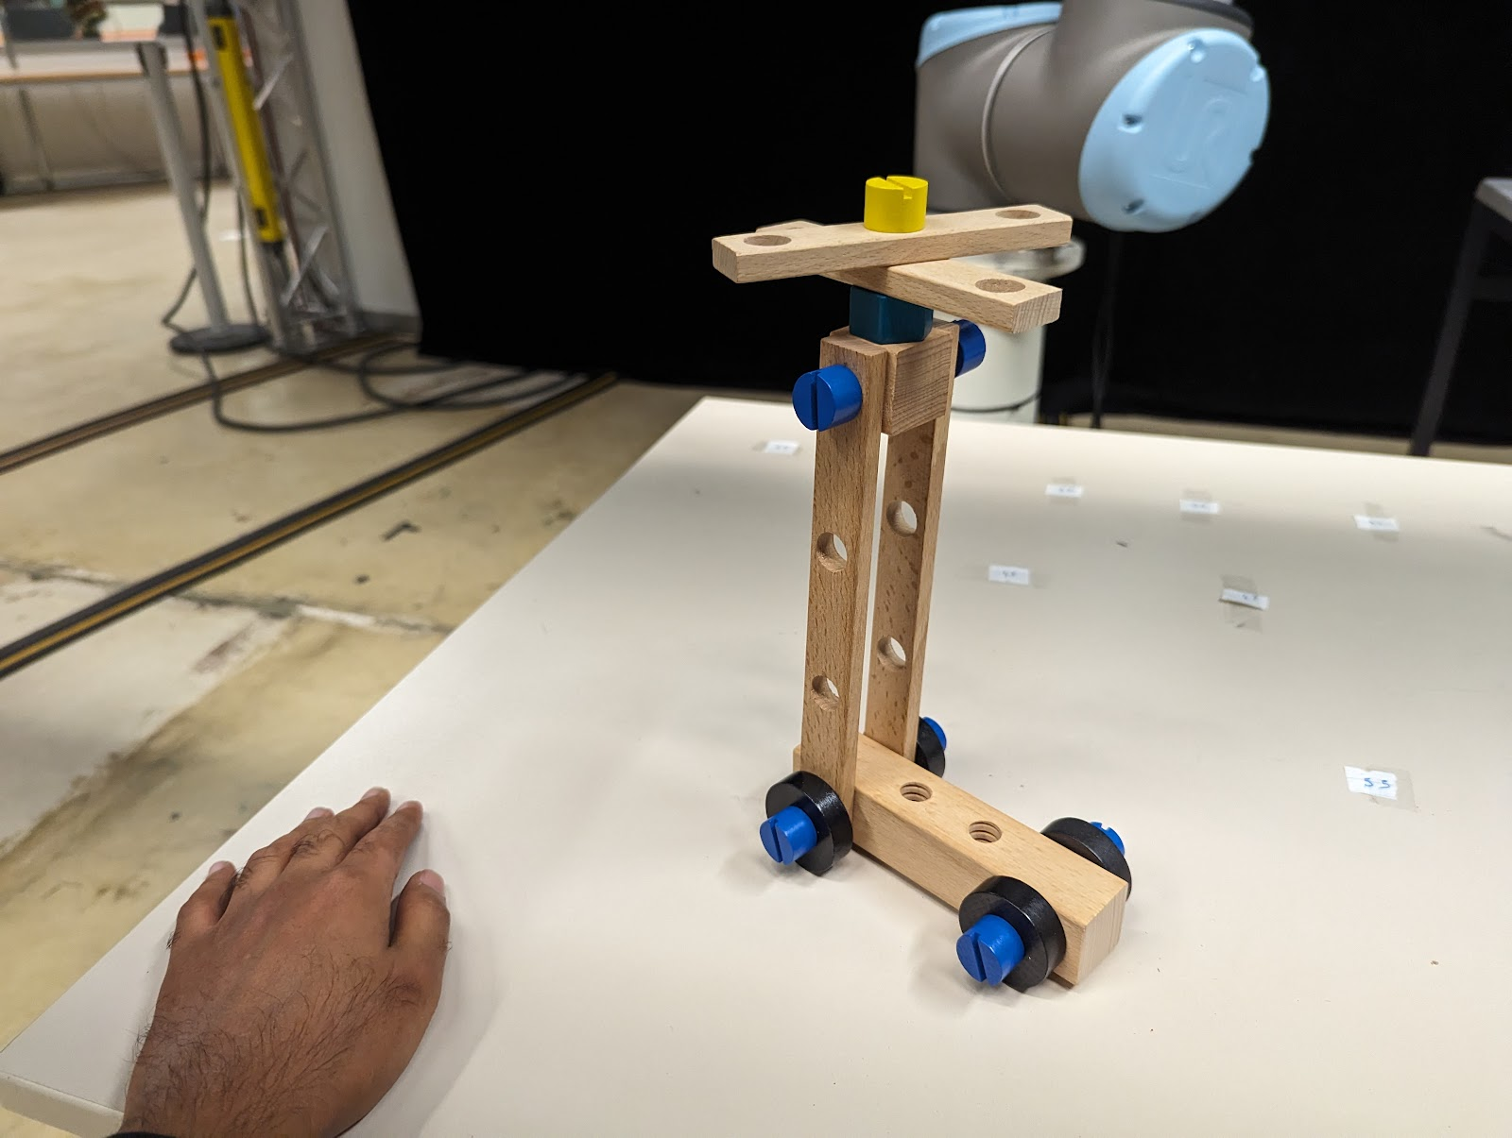
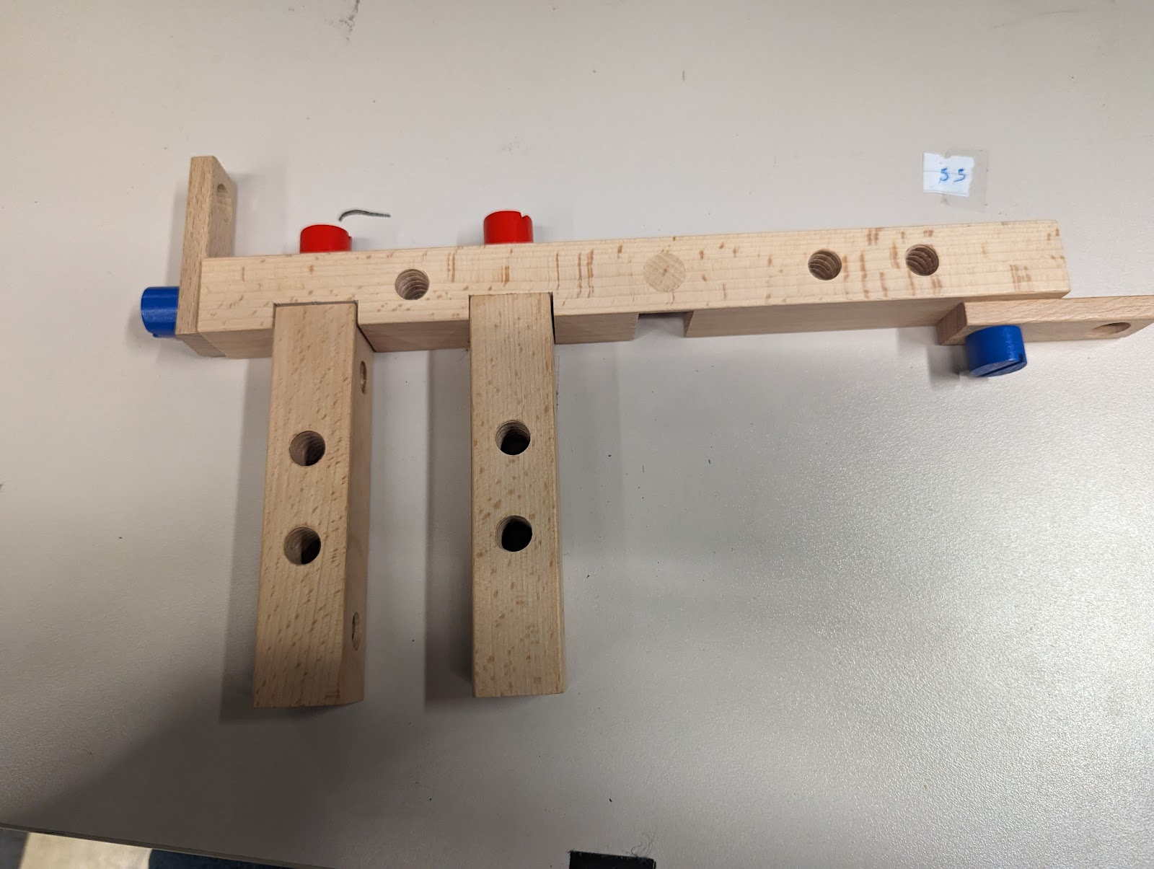
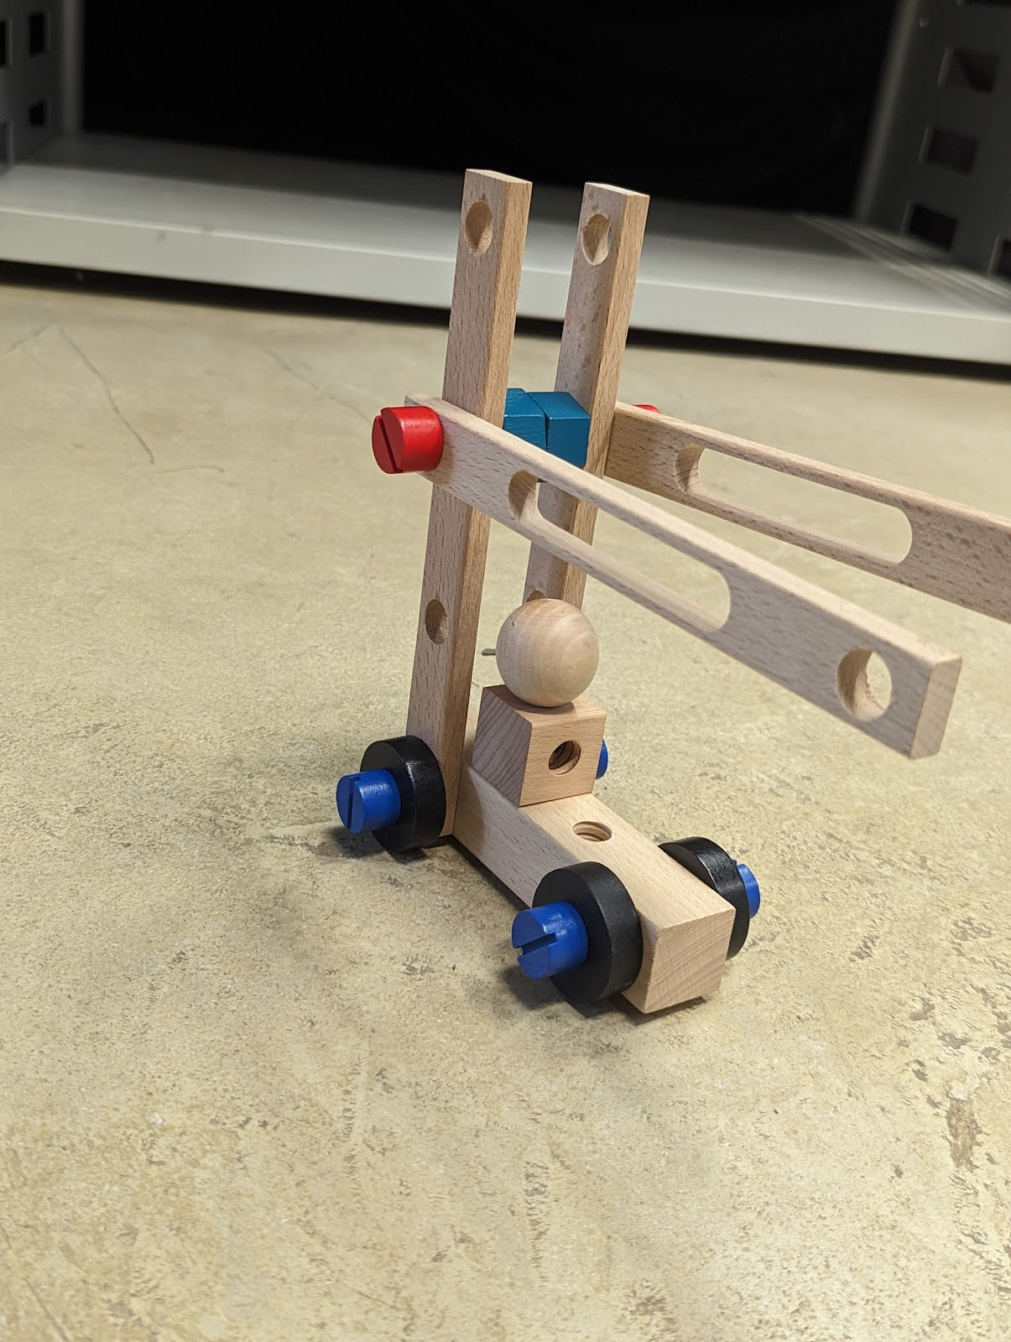
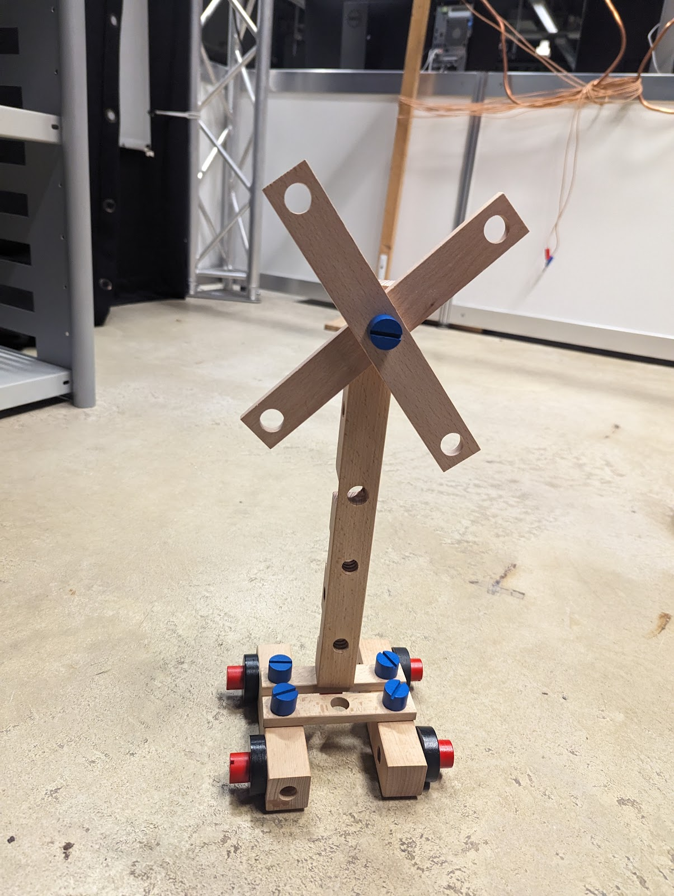
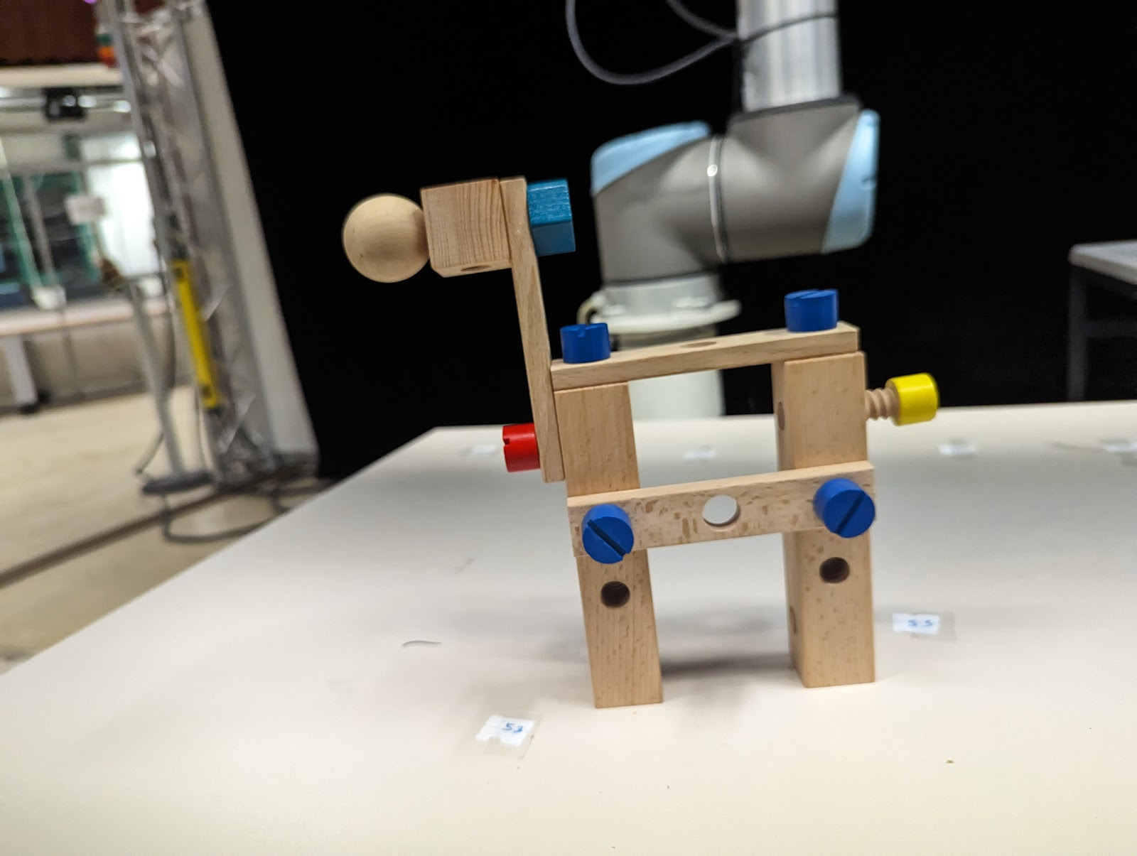
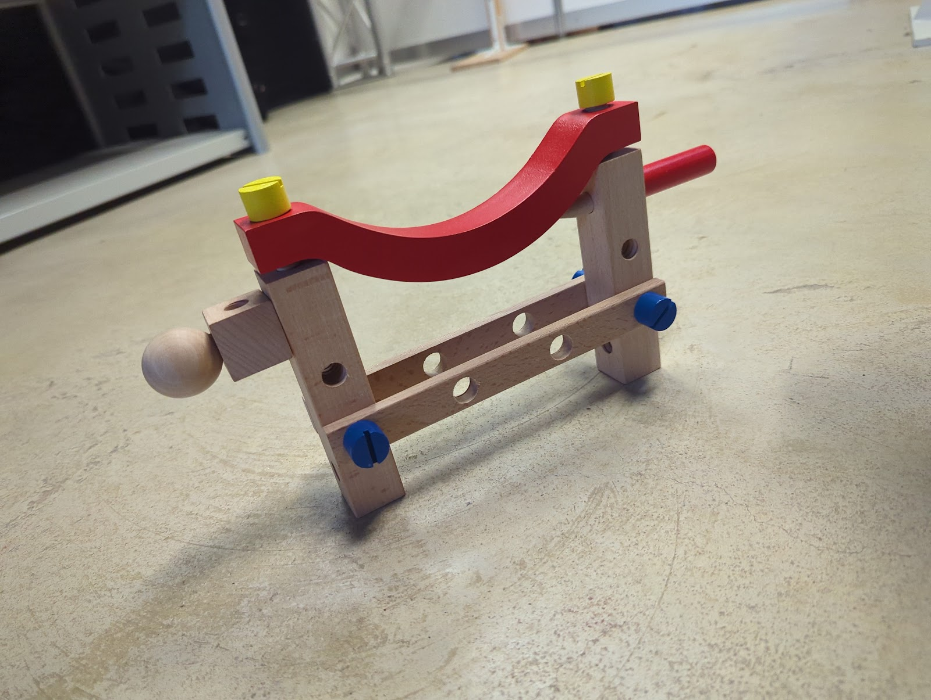
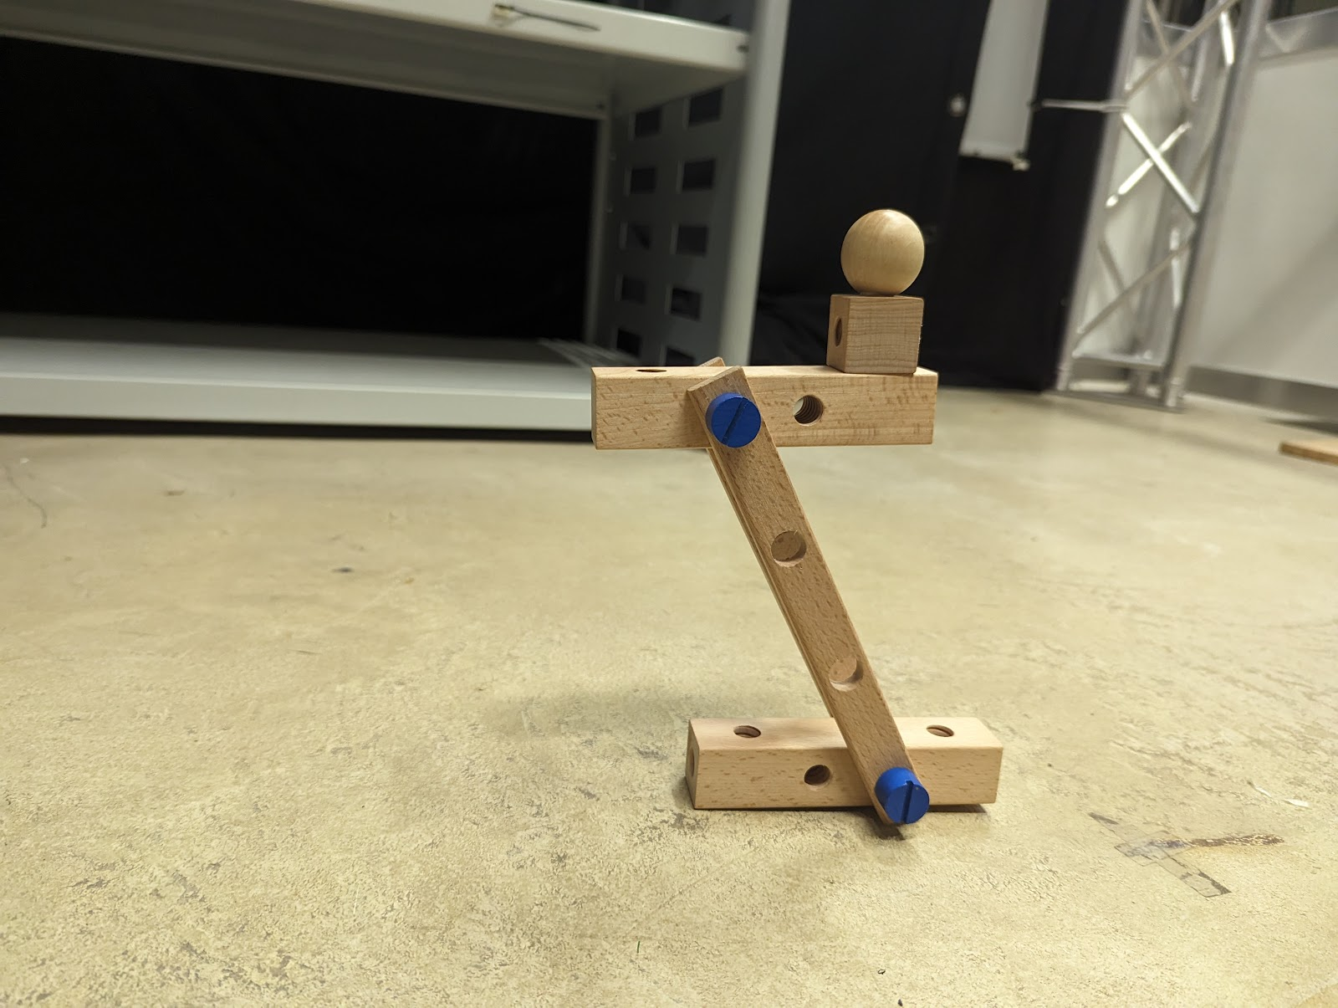
7 Different Tasks

Slide 11
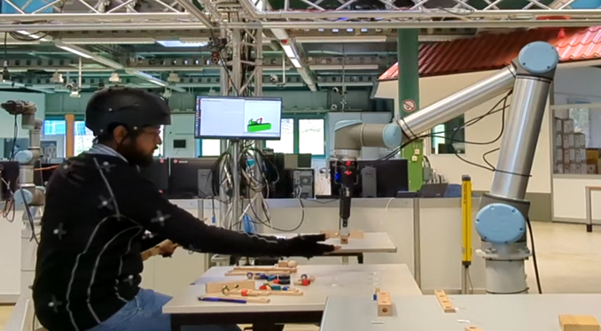
Objectives
Measure human physiological state during various human-robot interaction scenarios ie:
Experimental collaborative assembly task with participants(~20) while collecting subjective (questionnaires) and objective (wearable sensor) measurements to determine stress level.
Different Human-Robot Workspace
Different Workspace with no overlap
Shared Workspace
Shared Workspace with direct collaboration
Different Robot Collision Avoidance Strategies
No collision avoidance which stops at collision
Static collision avoidance
Predictive collision avoidance

Slide 12
Experiment Implementation
 | Different Workspace with no overlap | Shared Workspace | Shared Workspace with Direct Collaboration
No Collision Avoidance | ✗ | ✓ | ✓
Static Collision Avoidance | ✓ | ✓ | ✓
Predictive Collision Avoidance | ✗ | ✓ | ✓

Slide 13
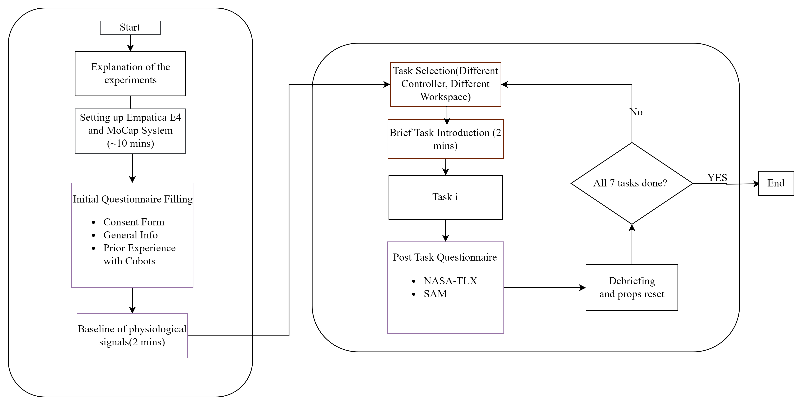
Experiment Implementation
NARS

Slide 14
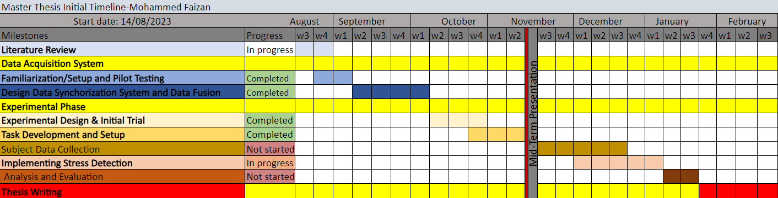
Next Steps and Remaining Timeline
´Remaining Tasks:
Data Collection (~1 month)
Finalising the stress detection (~6 weeks[Side by Side with Data Collection])
Evaluating results and Writing
Submission Date: 21.02.2024

Slide 17
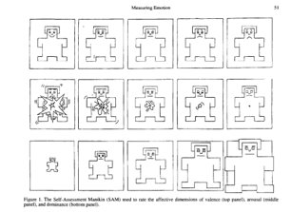
A Self-Assessment Manikin (SAM)to gather their affective state in the different task configurations by evaluating on a 9-point scale three dimensions: valence, arousal, and dominance.
Valence represents the pleasantness relative to a stimulus (for instance, happiness and relaxation are associated with a high valence, while anxiety or anger with a low valence).
Arousal refers to the intensity of emotion provoked by a stimulus (e.g., fear and anger are usually associated with a high arousal, while relaxation and boredom with a low arousal).
Dominance represents the degree of control felt relative to a stimulus (e.g., relaxation or anger are usually associated with a high dominance, while fear or anxiety with low dominance).

Slide 18
Progress and Things to do
Task development and implementation almost ready- Still need to define a proper protocol for the experiments and get final things tested and ready( Should be done by this week and ready for demo and start experiments next week)
Finalize the questionnaires and digitalize it(Jotforms or GoogleForms)

Slide 19
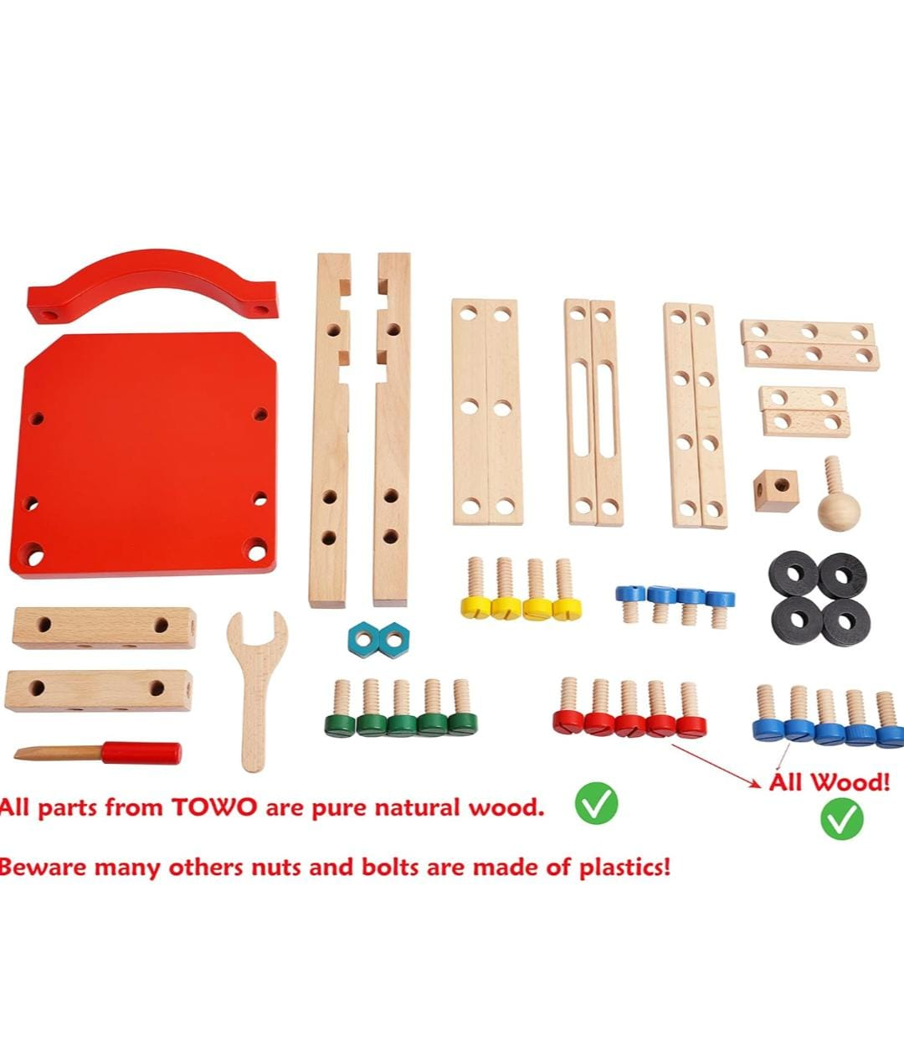
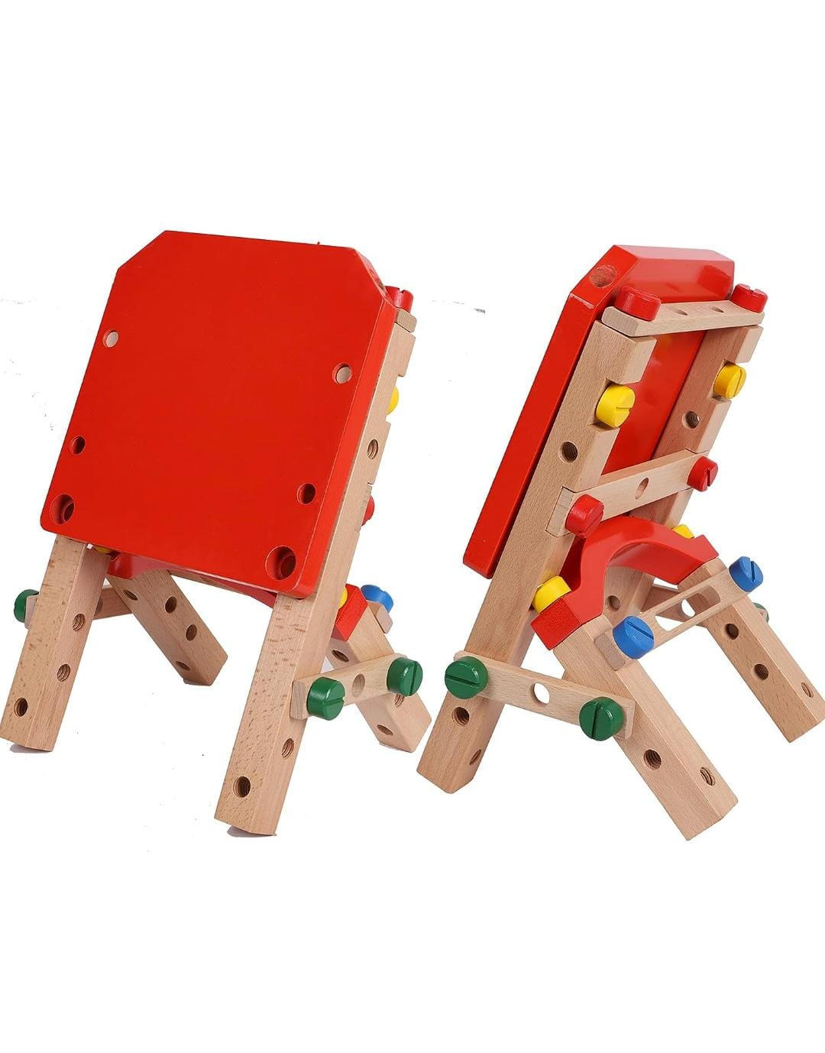
Sample Assembly Task

Slide 20
Sample Questionnaire
The State-Trait Anxiety Inventory (STAI) Vs NASA Task Load Index Vs Self-Assessment Manikin (SAM)
STAI ( 2 Times- Before and After all Experiments)
Differentiates between the temporary condition of "state anxiety" and the more general and long-standing quality of "trait anxiety."
Fairly Long 20 Questions
Not specific for task-related stress since it measures general anxiety, which is not always directly caused by tasks or workload.
NASA ( 3- Times – After each Collision Avoidance Task?)
It measures workload rather than stress or anxiety per se, but can useful for comparing the stress load between the different scenarios.
SAM(After Each Sub-task 3 Variations of WorkSpaces and 3 variation Collision Avoidance)
Pictorial representation and also shows a participant's emotional response in pleasure, arousal, and dominance, which can be particularly useful for measuring immediate reactions to a stimulus.

Slide 21
Designing of Experiments
Three types of controllers: default, static collision avoidance, and predictive collision avoidance.
Take different workspace into consideration, same workspace but no direct contact as trail and getting to know the experiment and then move on to actual collabrotive tasks?
Example experiment- Moving blocks and placing of bolt and human screwing
- Sorting of objects into bins. Robot picks object and gives it operator
What more can our robots do, how do I define the task?
Collection of subject data- Surveys etc to be made
Consent Forms/Anything else to be made to get ready for the experiments?

Slide 22
References
A. de Santos Sierra, C. S. Avila, J. G. Casanova, and G. B. del Pozo, ‘‘A stress-detection system based on physiological signals and fuzzy logic,’’ IEEE Trans. Ind. Electron., vol. 58, no. 10, pp. 4857–4865, Oct. 2011.
M. V. Villarejo, B. G. Zapirain, and A. M. Zorrilla, ‘‘A stress sensor based on galvanic skin response (GSR) controlled by ZigBee,’’ Sensors, vol. 12, no. 5, pp. 6075–6101, May 2012, doi: 10.3390/s120506075.
A. Sano and R. W. Picard, ‘‘Stress recognition using wearable sensors and mobile phones,’’ in Proc. Humaine Assoc. Conf. Affect. Comput. Intell. Interact., Sep. 2013, pp. 671–676.
Y. S. Can, N. Chalabianloo, D. Ekiz, J. Fernandez-Alvarez, G. Riva, and C. Ersoy, ‘‘Personal stress-level clustering and decision-level smoothing to enhance the performance of ambulatory stress detection with smartwatches,’’ IEEE Access, vol. 8, pp. 38146–38163, 2020
A. G. Airij, R. Sudirman, and U. U. Sheikh, ‘‘GSM and GPS based realtime remote physiological signals monitoring and stress levels classification,’’ in Proc. 2nd Int. Conf. BioSignal Anal., Process. Syst. (ICBAPS), Kuching, Malaysia, Jul. 2018, pp. 130–135.
] M. Gjoreski, M. Luštrek, M. Gams, and H. Gjoreski, ‘‘Monitoring stress with a wrist device using context,’’ J. Biomed. Informat., vol. 73, pp. 159–170, Sep. 2017
Y. S. Can, N. Chalabianloo, D. Ekiz, and C. Ersoy, ‘‘Continuous stress detection using wearable sensors in real life: Algorithmic programming contest case study,’’ Sensors, vol. 19, no. 8, p. 1849, Apr. 2019
M. Zubair and C. Yoon, ‘‘Multilevel mental stress detection using ultrashort pulse rate variability series,’’ Biomed. Signal Process. Control, vol. 57, Mar. 2020, Art. no. 101736.
Giakoumis, D.; Drosou, A.; Cipresso, P.; Tzovaras, D.; Hassapis, G.; Gaggioli, A.; Riva, G. Using activity-related behavioural features towards more effective automatic stress detection. PloS one 2012, 7, e43571.
Arnrich, B.; Setz, C.; La Marca, R.; Tröster, G.; Ehlert, U. What does your chair know about your stress level? IEEE Transactions on Information Technology in Biomedicine 2009, 14, 207–214
Elgendi, M. On the analysis of fingertip photoplethysmogram signals. Current cardiology reviews 2012, 8, 14–25
Garcia-Ceja, E.; Osmani, V.; Mayora, O. Automatic stress detection in working environments from smartphones’ accelerometer data: a first step. IEEE journal of biomedical and health informatics 2015, 20, 1053–1060.
Sano, A.; Picard, R.W. Stress recognition using wearable sensors and mobile phones. In Proceedings of the 2013 Humaine Association Conference on Affective Computing and Intelligent Interaction. IEEE, 2013, pp. 671–676
Giakoumis, D.; Drosou, A.; Cipresso, P.; Tzovaras, D.; Hassapis, G.; Gaggioli, A.; Riva, G. Using activity-related behavioural features towards more effective automatic stress detection. PloS one 2012, 7, e43571.

Slide 23
Overveiw of Stress detection studies using PPG and Motion
Paper | Signals Used | Technique | Result
[1] | GSR, HR | Fuzzy Decision Algorithm was used for manual and automatic implementation of the proposed approach. | 90% Accuracy
[2] | GSR | WEKA learning machine was used for testing Bayesian Network (BN), J48, and Sequential Minimal Optimization (SMO). | Detected different states of each user with a success rate of 76.56%.
[3] | ACC and skin conductance | evaluated performance using the following six classifiers -SVM with linear kernel -SVM with Radial basis function (RBF) -KNN (k=1-4) -PCA and SVM with linear kernel -PCA and SVM with Radial basis function (RBF) -PCA and KNN (k=1-4) | This system gives over 75% accuracy of low and high perceived stress recognition using the sensor data.
[4] | HR, Skin Conduct ance, ACC, ST | The WEKA Toolkit was used for classification algorithms. 2. PCA & SVM with a linear Kernel, RF (with 100 trees), KNN (n=1), PCA & Linear Discriminant analysis (LDA), and MultiLayer Perceptron (MLP) were used for classification. | 1. The maximum classification accuracy was 94.52% and minimum accuracy was 91% for 3 classes. 2. They developed a session-based stress classifier that gives a maximum of 94.44% accuracy with HR and 100% with EDA signals.
[5] | HR, Skin conducta nce, ST | A rule-based fuzzy logic algorithm was proposed and used for stress level classification. Also, decision tree, KNN, and Naïve Bayes algorithm were used for comparison of accuracy. | The overall accuracy achieved by the system was 96.19% by using a proposed fuzzy logic algorithm.
[6] | HR, EDA, BVP, ST, ACC | A variety of machine learning algorithms were experimented on the dataset using LOSO evaluation which is – majority classifier, J48, Naïve Bayes, KNN, SVM, Bagging, Boosting, RF, Ensemble selection | This method detected 70% of the stress events with a precision of 95%.

Slide 24
Overveiw of Stress detection studies using PPG and Motion
Paper | Signals Used | Technique | Result
[7] | GSR, ACC,BVP;ST | 1. Fast Fourier Transform (FFT) and Lomb-Scargle periodogram were applied for feature extraction. 2. PCA & LDA, PCA & SVM with the radial kernel, KNN (n=1), Logistic Regression, RF (with 100 trees), and multilevel perceptron were used as a classifier with 10-fold crossvalidation. | 1. For 3 class stress level detection, 90.40% accuracy was obtained by using Empatic E4 device . 2. Achieved maximum 97.92% accuracy with their person-specific models while 88.20% for general models. 3. RF and Multilayer Perceptron performed best among all classifiers.
[8] | GSR, ACC,BVP;ST | 1. Quadratic discriminant analysis and SVM were used as classifiers and LOSO (leave-one-subject-out) used for evaluation of classification performance. 2. To capture the stressrelated temporal information, a set of new Poincare plot features was used. | SVM gives 94.33% accuracy for the detection of fivelevel stress.
[9] | GSR,ECG,ACC,Body Posture | Behavioral body language features used in the study are visual cues that are extracted from the data acquired by Kinect and an HD camera. Classification is performed using linear discriminant analysis | Maximum classification accuracy of 96.30% is achieved.
[10] | Posture Data | A rule-based fuzzy logic algorithm was proposed and used for stress level classification. Also, decision tree, KNN, and Naïve Bayes algorithm were used for comparison of accuracy. | The overall accuracy achieved by the system was 96.19% by using a proposed fuzzy logic algorithm.

Slide 25
Pre-Processing
EDA through a low-pass filter to remove high frequency noise
EDA segmentation into a slow-varying baseline conductivity known as skin conductance level (SCL) and a high-frequency component called skin conductance response (SCR)

Slide 26
Possible Feature Extraction
ACC-Features for accelerometer sensors in stress recognition studies include mean, standard deviation, variance, maximum, absolute value, signal magnitude area, root mean squared, energy, differential entropy, discrete Fourier transform, peak magnitude frequency, peak power, and zero crossing [7,12,13]
GSR(EDA)-statistical features of mean, standard deviation, mean of the absolute values, root mean square, the proportion of negative samples, the slope of the EDA level, mean EDA peak rate, and height, minimum and maximum have been commonly used [14, 15].
BVP-HR,HRV,the Inter-Beat-Interval (IBI).
For Motion?

Slide 27
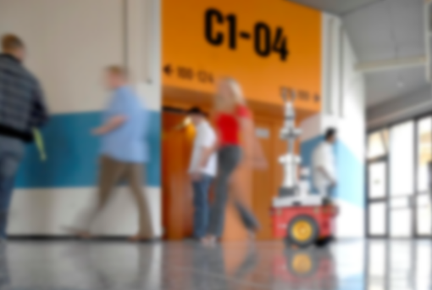
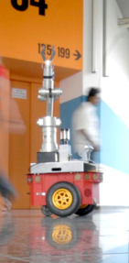

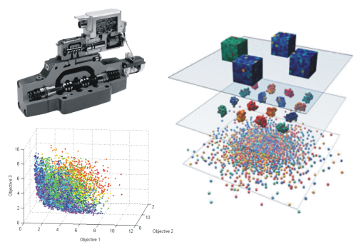
Thank you for your kind attention!

Slide 28
E4 Topics
1.biosensors/empatica_e4/bvp :
type: standard_msg/Float32
size: 1-by-1
detail:the Blood Volume Pulse (BVP) signal( Value is derived from the light absorbance of the arterial blood).
Average Freq: 60
2.biosensors/empatica_e4/gsr :
type: standard_msg/Float32
size: 1-by-1
detail: Galvanic Skin Response (GSR) signal.
Average Freq:4
3. biosensors/empatica_e4/hr :
Type: standard_msg/Float32
size: 1-by-1
detail: the Heart Rate (HR) signal. Freq:1.1
4. biosensors/empatica_e4/st :
Type: standard_msg/Float32
size: 1-by-1
detail: Skin Temperature (ST) signal
Freq: 0.6
5. biosensors/empatica_e4/ibi :
type: standard_msg/Float32
size: 1-by-1
detail: the Inter-Beat-Interval (IBI) signal. ( value is the distance from the previous detected heartbeat in seconds.)
Freq: 1.2
6. biosensors/empatica_e4/acc :
type: standard_msg/Float32MultiArray
size: 1-by-1
detail: the accelerometer (ACC) data.
Average Freq: 31
7. biosensors/empatica_e4/bat :
type: standard_msg/Float32
size: 1-by-1
detail: the Battery Level (BAT) signal.

Slide 29
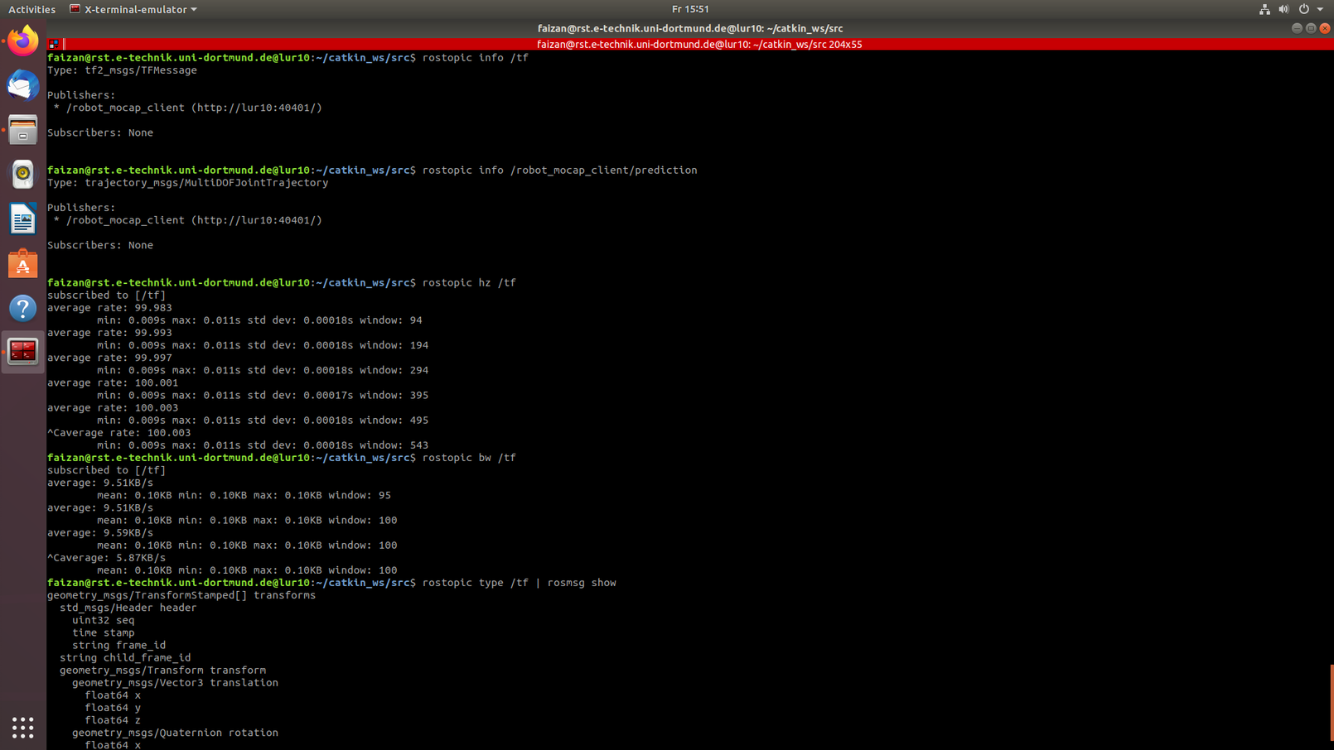
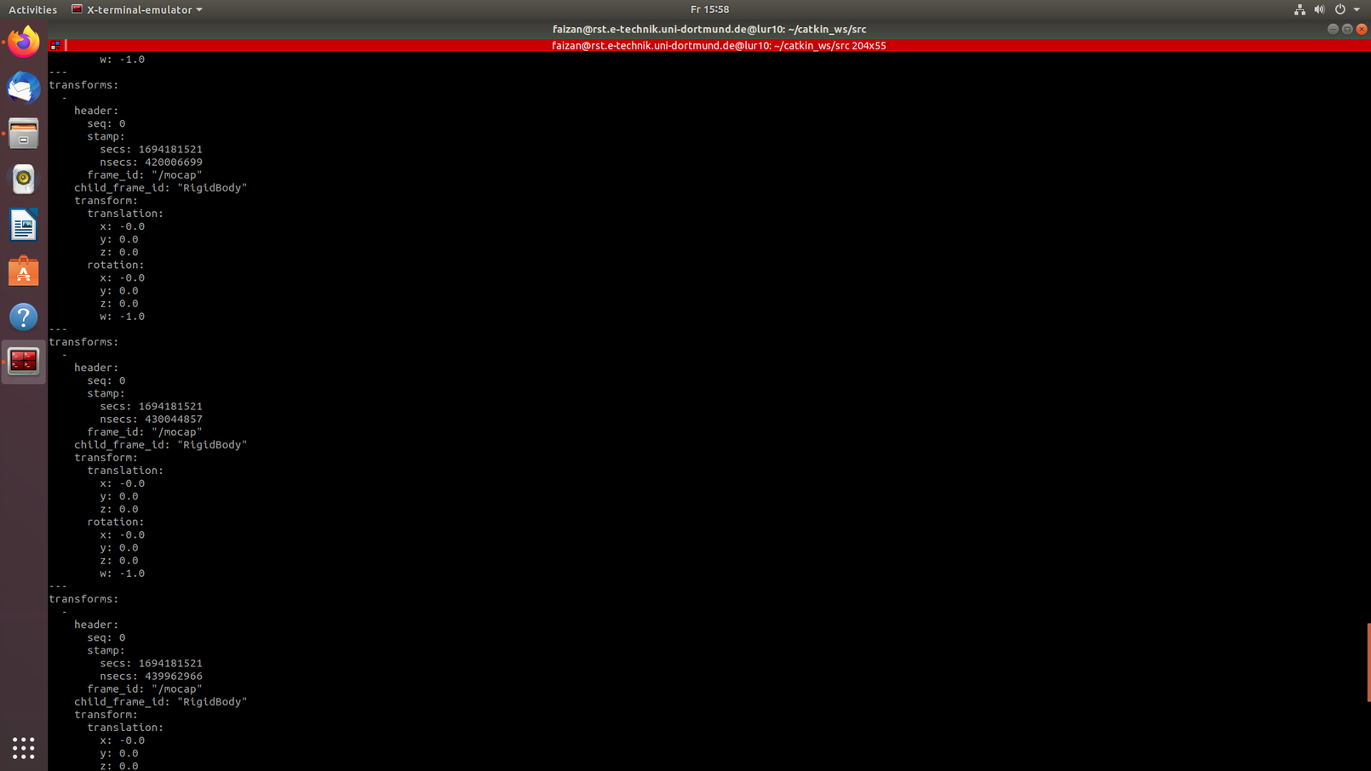
MoCap Topic

Slide 30
Gliederung
Einleitung
Inaktive Ebene
Aktive Ebene (RGB: 132/184/24)
VERWENDE “Layouts” für die Bearbeitung
Zusammenfassung

Slide 31
Outline
Introduction
Inactive Layer
Active Layer (RGB: 132/184/24)
USE “Layouts” for modifications
Conclusions

Slide 32
erste Ebene: schwarz, normal, Arial, 22 hervorzuhebende Ausdrücke: apfelgrün und fett (RGB: 132 184 24) oder orange und fett (RGB: 255 102 0)
zweite Ebene: schwarz, normal, Arial, 20; apfelgrün orange
dritte Ebene: grau, normal, Arial, 18; apfelgrün orange

Slide 33
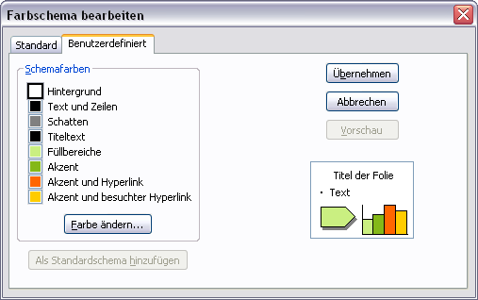
Farbschema
Weitere Farben zum Hervor- heben und Farbighinterlegen (Transparenz = 0%, da sonst teilweise karierte Darstellung möglich)
Farbschema
RGB | Rand | Füllung
 | 132 184 24 | 202 239 129
 | 255 102 0 | 255 173 117
 | 0 102 255 | 139 186 255
 | 255 204 0 | 255 233 139

Slide 34
TeX Formeln
Formeln im Latex-Stil lassen sich bequem mit Hilfe des IguanaTex Plugins in die Folien einbinden (Windows): http://www.jonathanleroux.org/software/iguanatex/
Nachhaltige, wiederwertbare Foliensätze am Lehrstuhl RST sollten grundsätzlich nur mit Boardmitteln + IguanaTex erstellt werden.
Für Mac OSX Benutzer gibt es eine Alternative, Kompatibilität mit IguanaTex ist ausgeschlossen und daher sollte diese nur in wenigen Fällen Verwendung finden (z.B. in Abschlussarbeiten): http://www.chachatelier.fr/latexit/

Slide 35
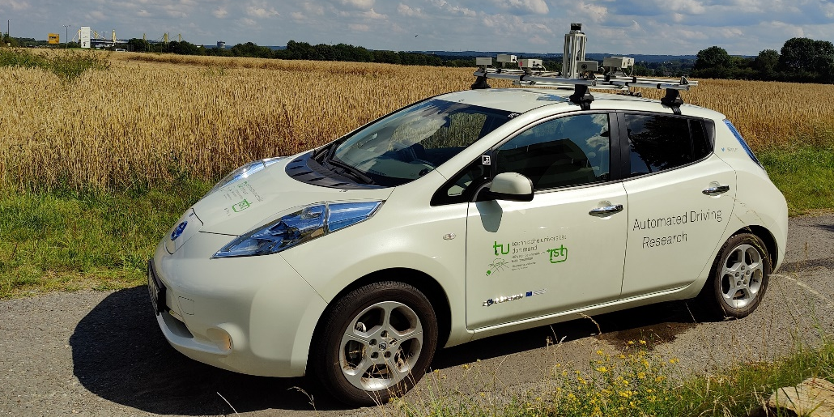
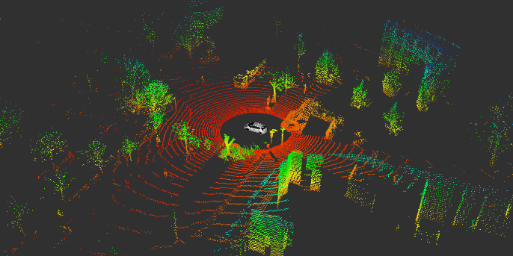
Thank you for your kind attention!
Univ.-Prof. Dr.-Ing. Prof. h.c. Dr. h.c. Torsten Bertram
Institute of Control Theory and Systems Engineering

Slide 36
Vielen Dank für Ihre Aufmerksamkeit!
Univ.-Prof. Dr.-Ing. Prof. h.c. Dr. h.c. Torsten Bertram
Lehrstuhl für Regelungssystemtechnik

Slide 37
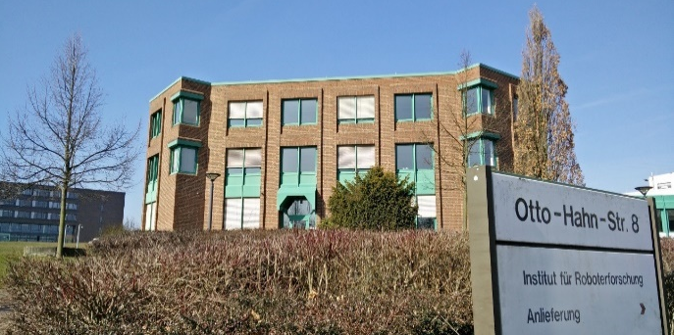
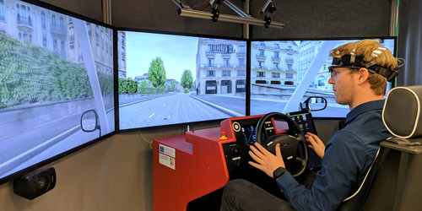
Vielen Dank für Ihre Aufmerksamkeit!
Univ.-Prof. Dr.-Ing. Prof. h.c. Dr. h.c. Torsten Bertram
Lehrstuhl für Regelungssystemtechnik

Slide 38
Thank you for your kind attention!
Univ.-Prof. Dr.-Ing. Prof. h.c. Dr. h.c. Torsten Bertram
Institute of Control Theory and Systems Engineering

Slide 39
Vielen Dank für Ihre Aufmerksamkeit!
Univ.-Prof. Dr.-Ing. Prof. h.c. Dr. h.c. Torsten Bertram
Lehrstuhl für Regelungssystemtechnik

